Slide 1
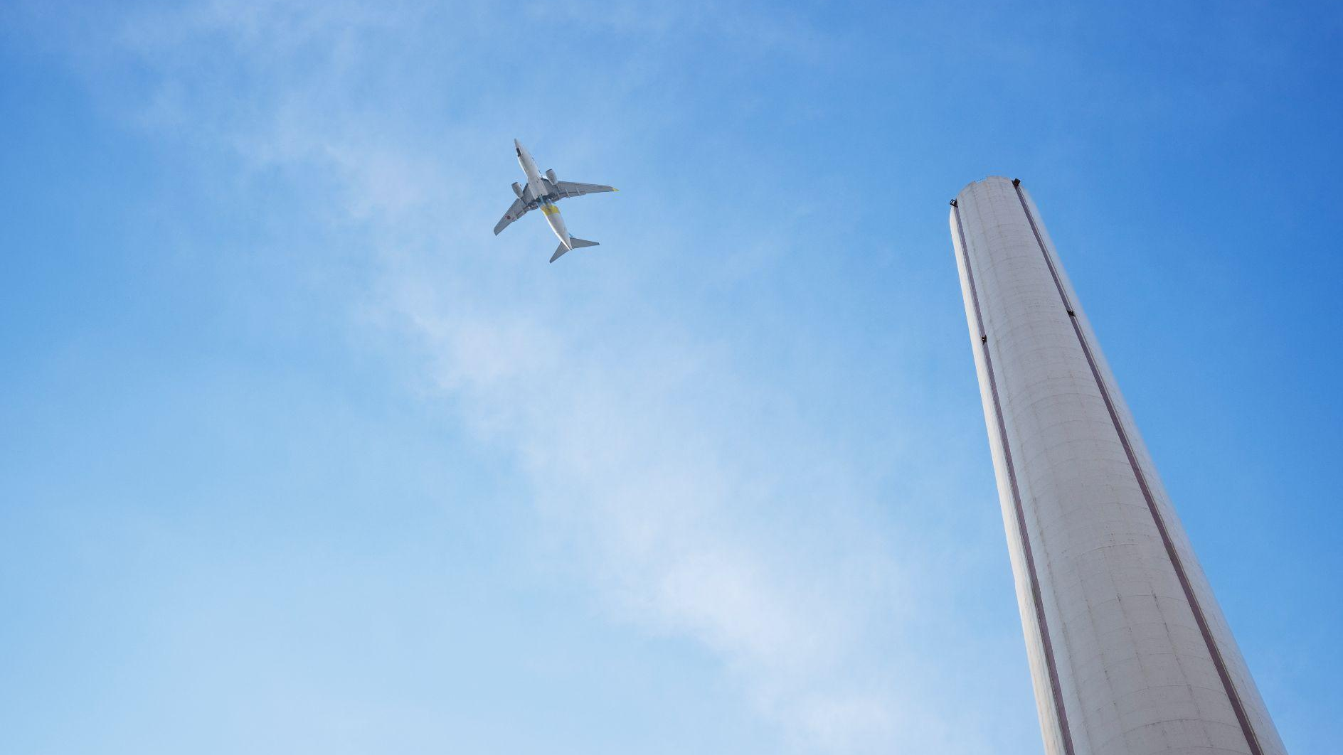


MIS 587 Flight Delay Analysis

Slide 2
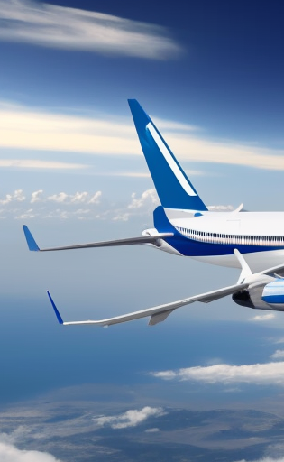
Agenda
1
2
3
4
Industry Overview
Vyshnavi
Data Warehouse Design & ETL
Isha
Exploratory Data Analysis
Ankit
Data Visualizations
Ben
5
Business Implications
Shreyas
Vyshnavi | 1

Slide 3
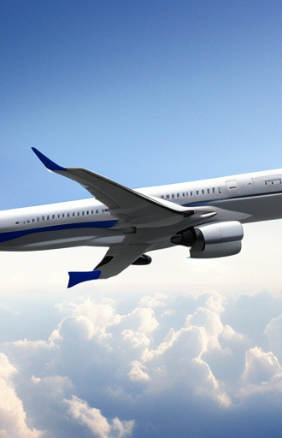
Industry Overview

Slide 4
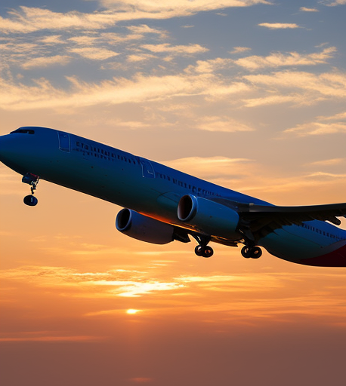
Industry Overview
The global airline market, valued at approximately $520 billion in 2023, is projected to nearly double, reaching around $1.1 trillion by 2030.
Flight delays cost the U.S. economy approximately $32.9 billion annually, with airlines and airports bearing $8.3 billion and $2 billion of those costs, respectively.**
The aim is to provide an in-depth analysis of departure and arrival delay patterns, draw insights, and suggest recommendations to airports and airlines.
**Source : FAA Report

Slide 5
Dataset Description
Total number of records of data : 280K
FlightID: Unique flight identifier.
FlightDate: Scheduled departure date.
Origin: Departure airport code.
Dest: Arrival airport code.
Cancelled: Flight cancellation indicator (1 for yes, 0 for no).
Diverted: Flight diversion indicator (1 for yes, 0 for no).
CRSDepTime: Scheduled departure time.
DepTime: Actual departure time.
DepDelay: Departure delay in minutes.
ArrTime: Actual arrival time.
AirTime: Flight duration.
CRSElapsedTime: Scheduled flight duration.
ActualElapsedTime: Actual flight duration.
Distance: Total flight distance.
Year: Year of the flight.
Operating_Airline: Operating airline.
Flight_Number_Operating_Airline: Operating airline's flight number.
OriginAirportID: Origin airport identifier.
DestAirportID: Destination airport identifier.
TaxiOut: Time from gate departure to takeoff.
TaxiIn: Time from landing to gate arrival.
CRSArrTime: Scheduled arrival time.
ArrDelay: Arrival delay in minutes.

Slide 6
Dimensional Modelling Process
Identify Facts
4
Flights Fact
Identify Dimensions
3
Airport, Airline, Date, Time
Declare the grain
2
Individual Flights
1
Choose Business Process
Flight delay analysis for airlines and airports

Slide 7
Data Warehouse Design & ETL

Slide 8
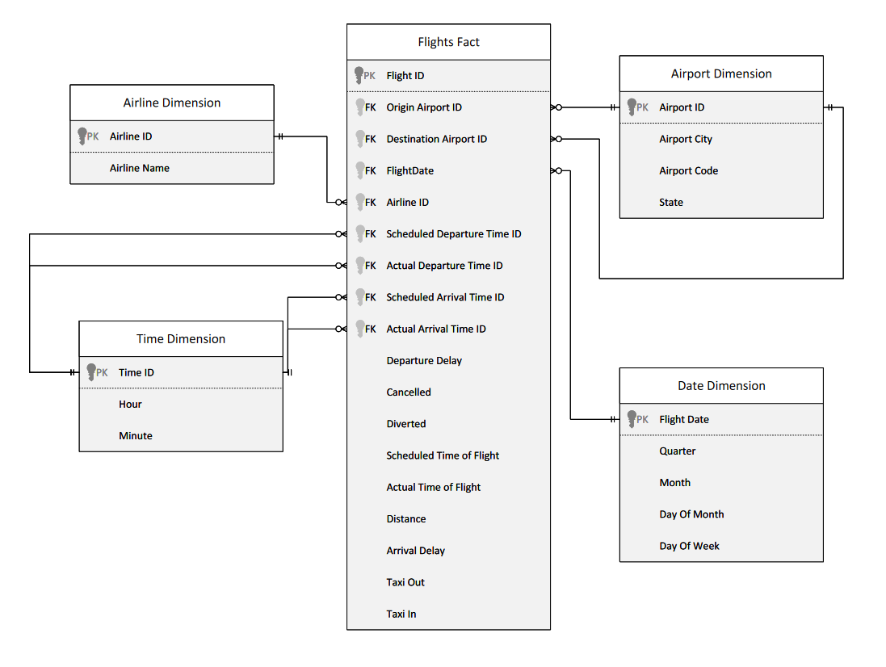
Star Schema
Role Playing Dimension
Role Playing Dimension

Slide 9
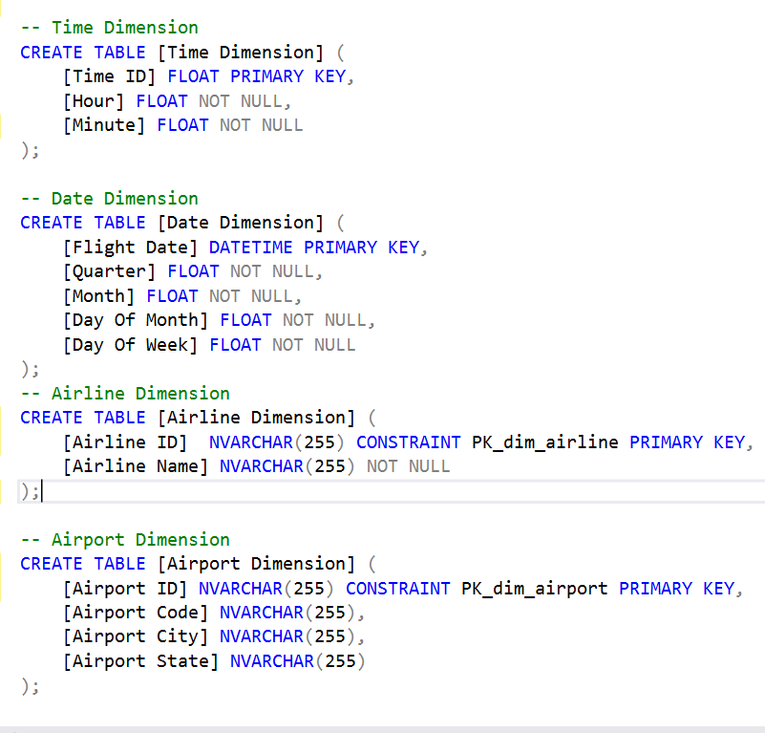
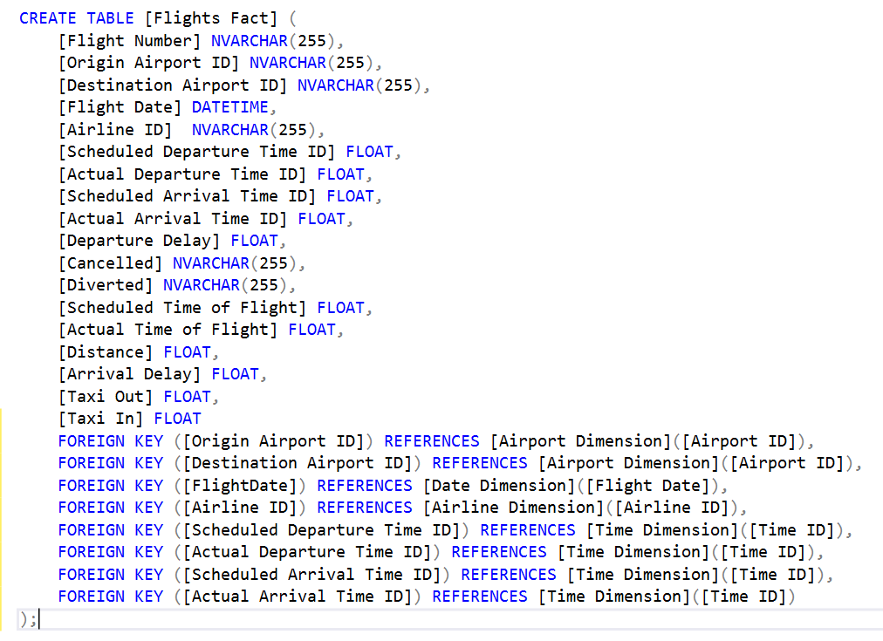
Data Warehouse Implementation

Slide 10
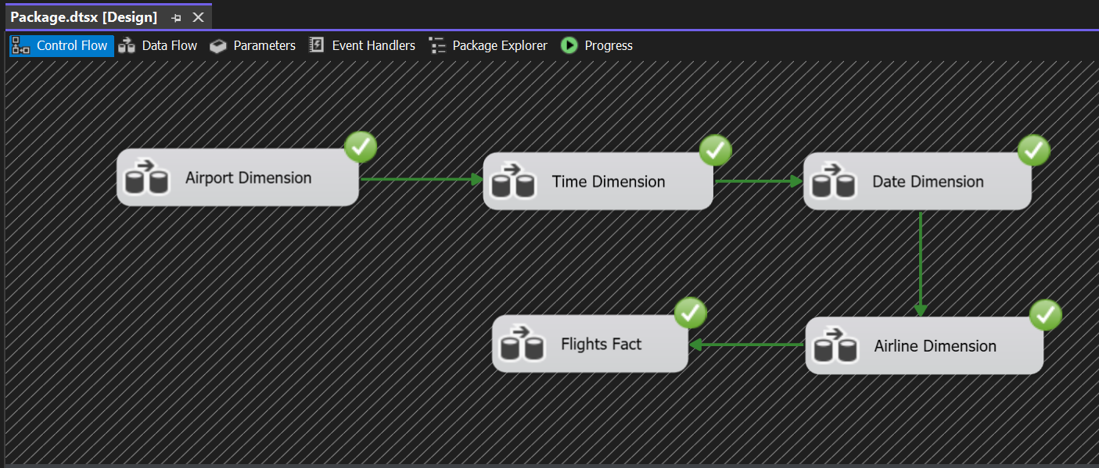
ETL Control Flow

Slide 11
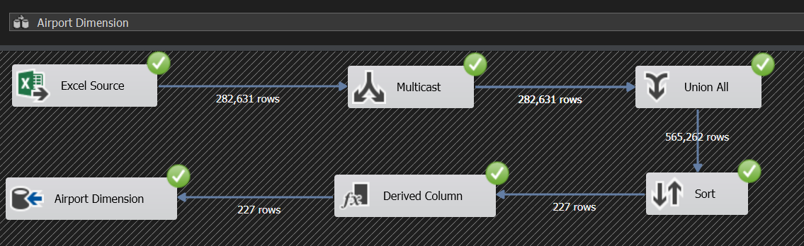
Airport Dimension
Combines data from origin airports & destination airports
Transforms input to multiple outputs
Removes Duplicates

Slide 12
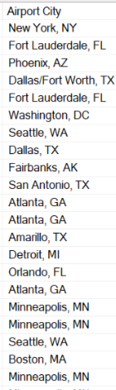
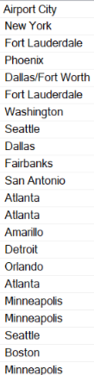
Derived Column
Expression Used to get city part
LEFT(OriginCityName, FINDSTRING(OriginCityName, ",", 1) - 1)

Slide 13
Exploratory Data Analysis

Slide 14
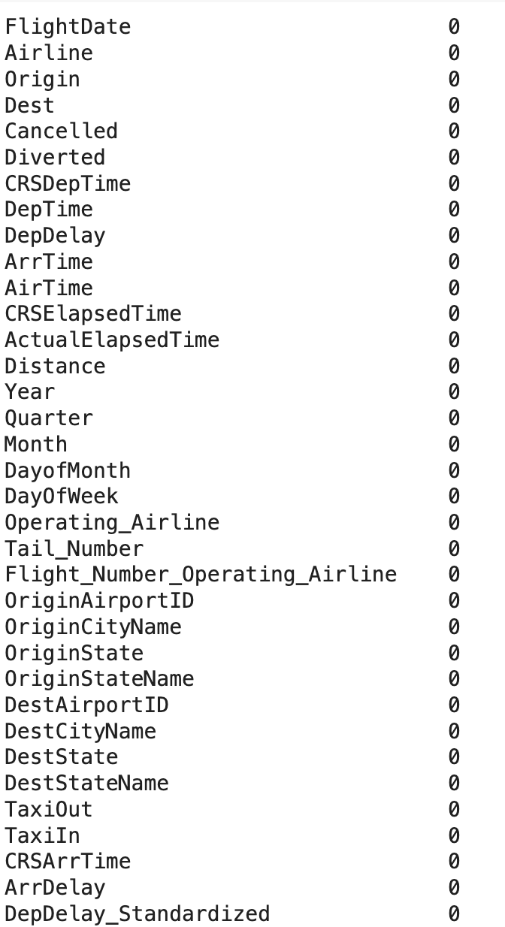
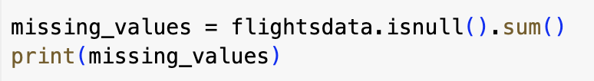
Data Cleaning
Check for missing values
The dataset does not contain any missing values, which is excellent for our analysis.

Slide 15
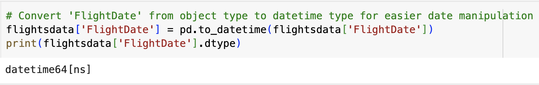
Data Preparation
Convert FlightDate to datetime

Slide 16
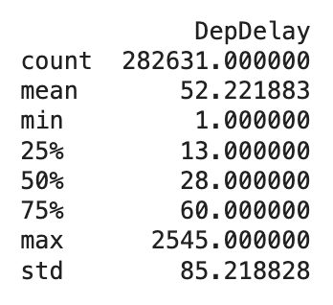
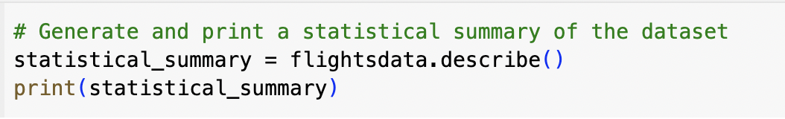
Exploratory Data Analysis
1. Statistical Summary
Departure Delay: The average delay is around 52 minutes for departures
Minimum and Maximum Delays: The minimum recorded delay is 1 minute, and the maximum delays reach up to 2545 minutes for departures, this indicates the presence of outliers.

Slide 17
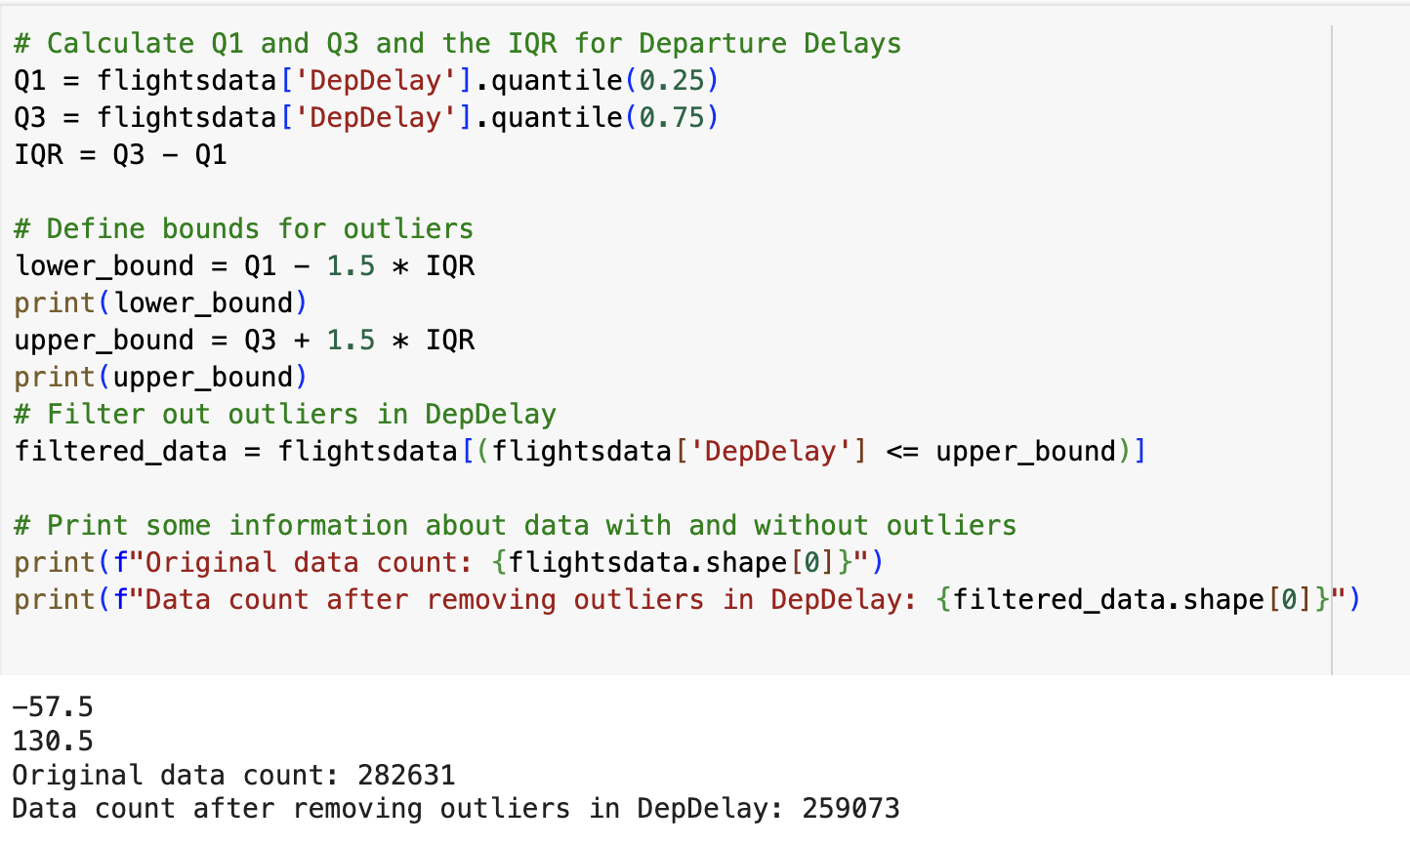
Exploratory Data Analysis
2. Checking for outliers

Slide 18
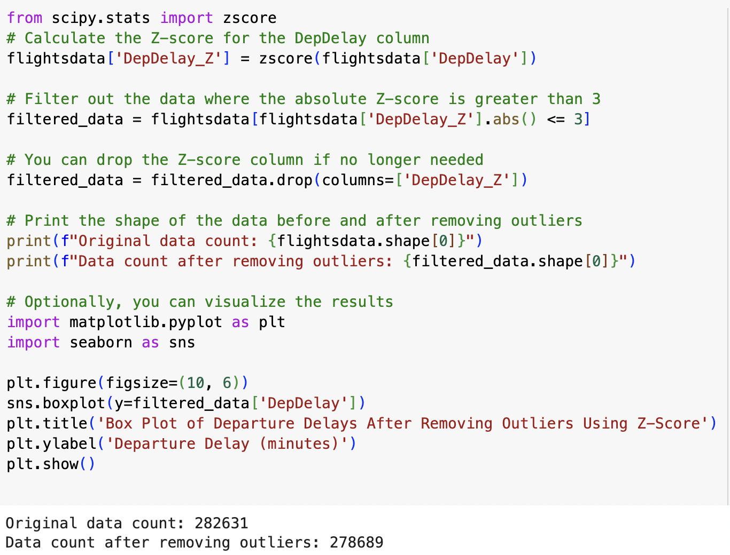
Exploratory Data Analysis

Slide 19
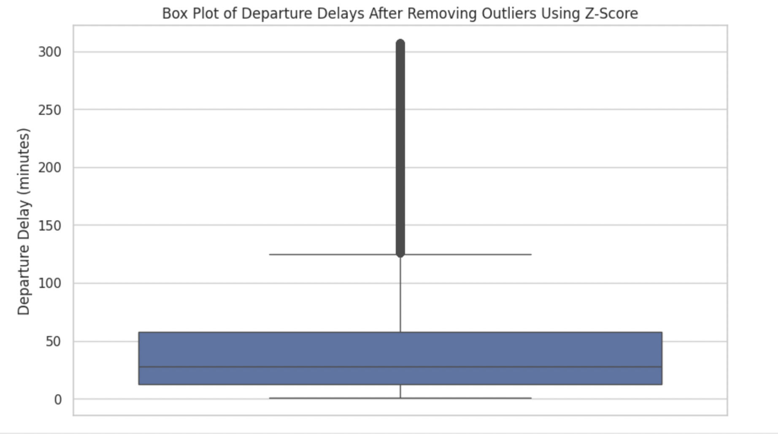
Exploratory Data Analysis

Slide 20
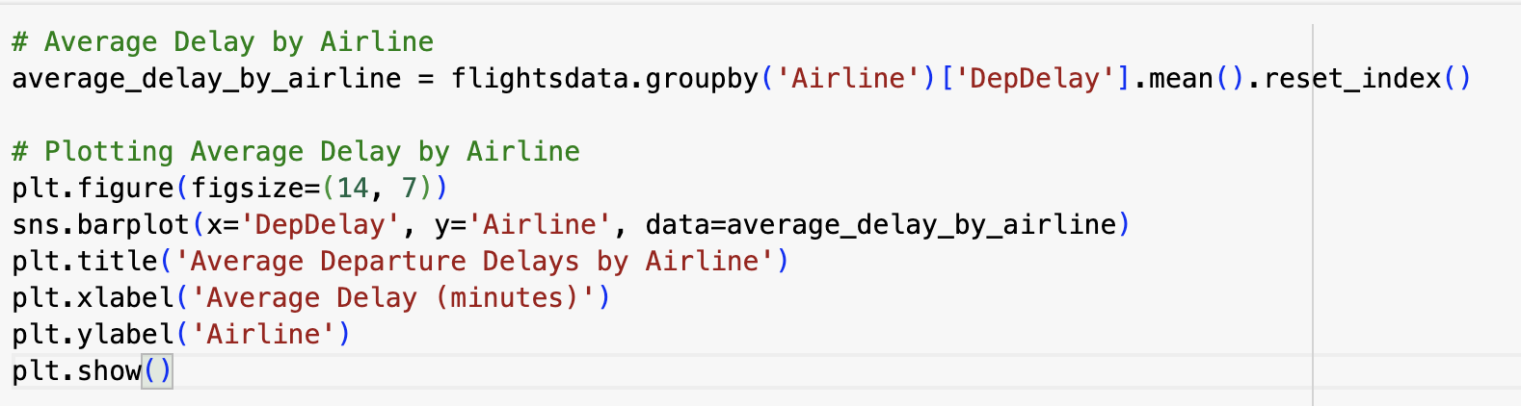
Exploratory Data Analysis
3. Visual Exploration

Slide 21
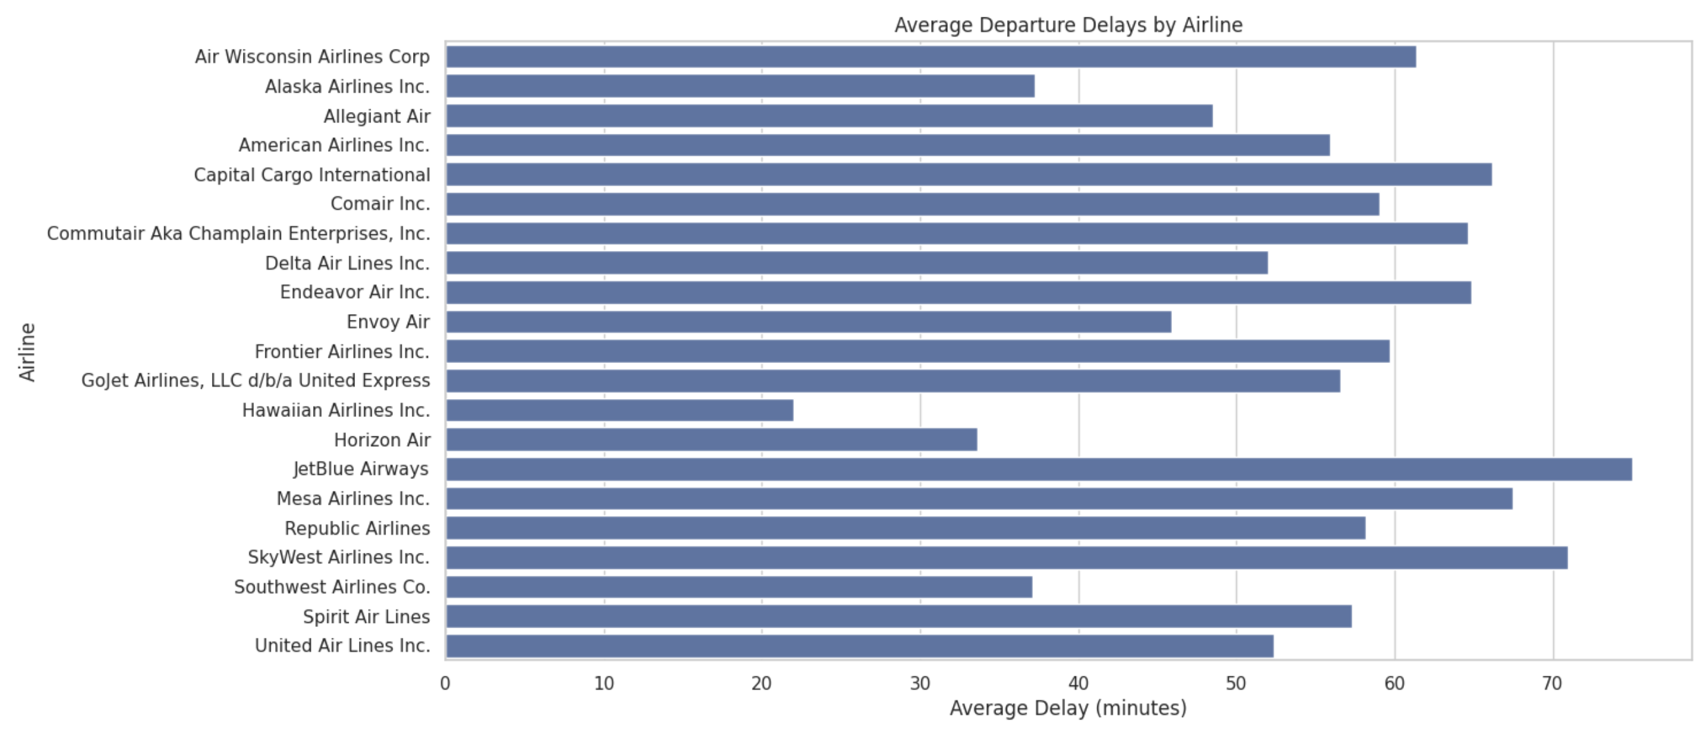
Exploratory Data Analysis

Slide 22
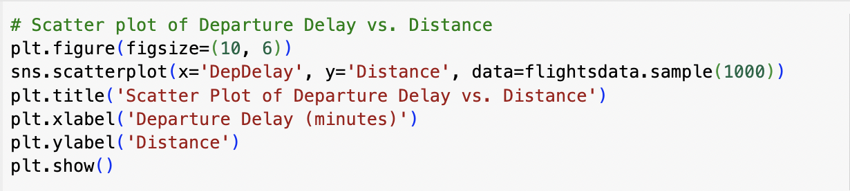
Exploratory Data Analysis

Slide 23
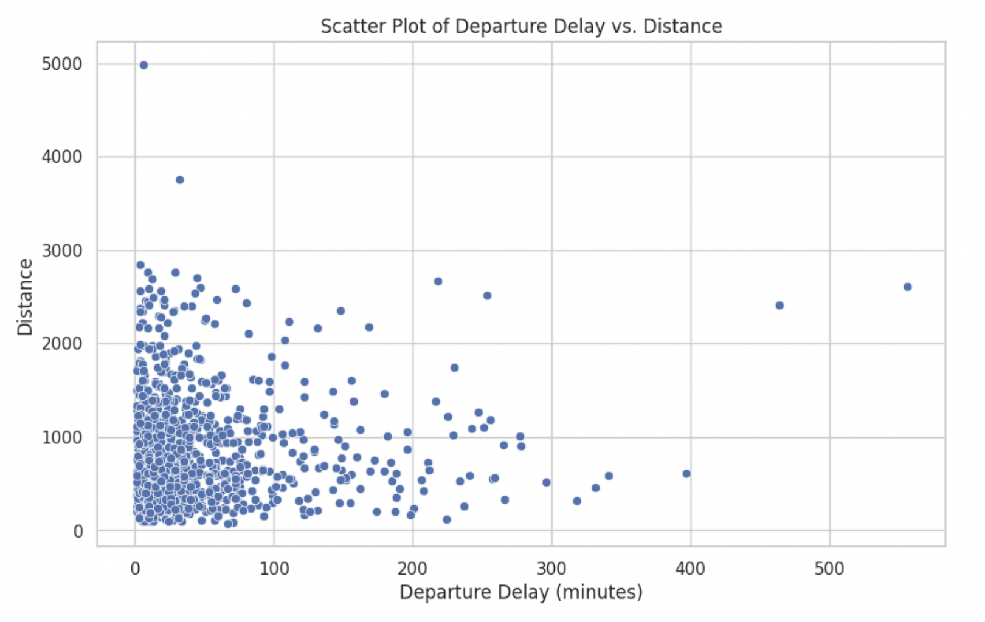
Exploratory Data Analysis

Slide 24
Conclusion and Utility of EDA
Summary Statistics: Mean, median, mode, standard deviation helps to understand the central tendency of data
Data Cleaning: Handling missing values, outliers and other inconsistences ensure reliability of analysis.
Data Visualization : Histograms, scatterplots, box plots help to explore distribution, relationship and trends in data
Correlation Analysis: Examining relationships between variables help to understand dependencies and identify potential predictors

Slide 25
Data Visualizations

Slide 26
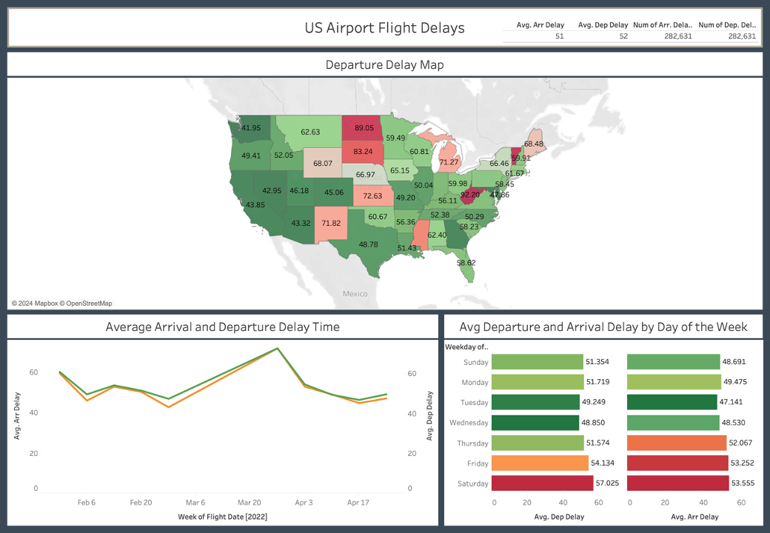
US Flight Delays
Avg between 51 – 52 minutes nationwide
Longer delays occur in rural states
West Coast has shorter delays compared to the East Coast
Friday and Saturday have the longest delays of the week

Slide 27
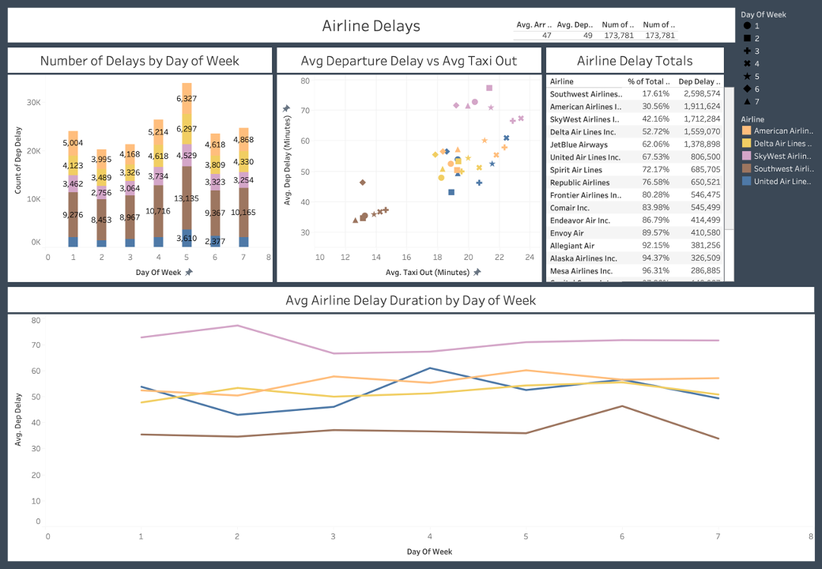
Airline Analysis
Customers are most likely to experience a delay flying
Southwest Airlines
Customers flying SkyWest Airlines will experience the
longest delays
Departure delays are unrelated to taxi out time

Slide 28
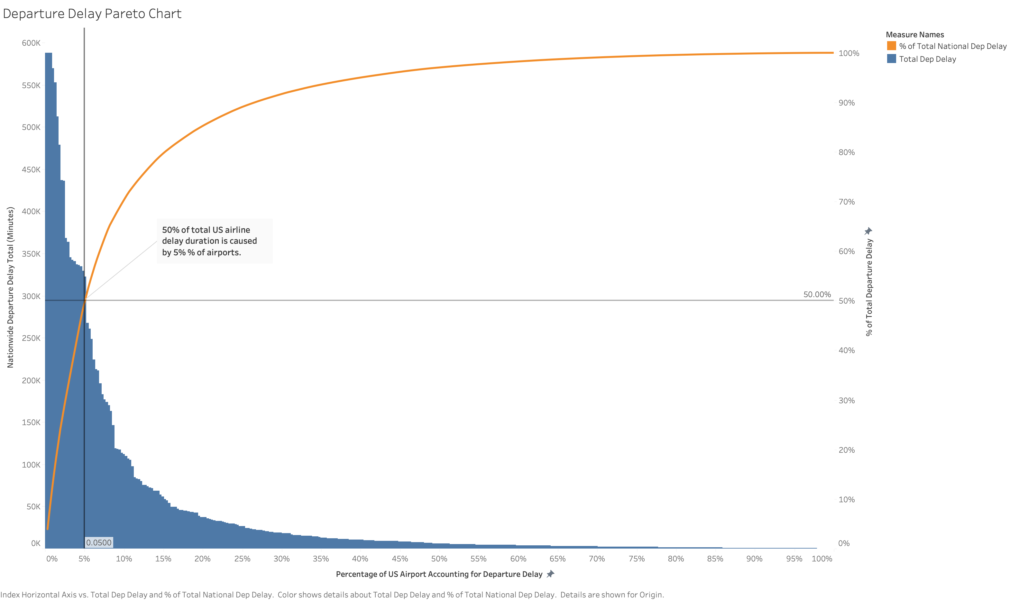
50% of Delays at 5% of Airports

Slide 29
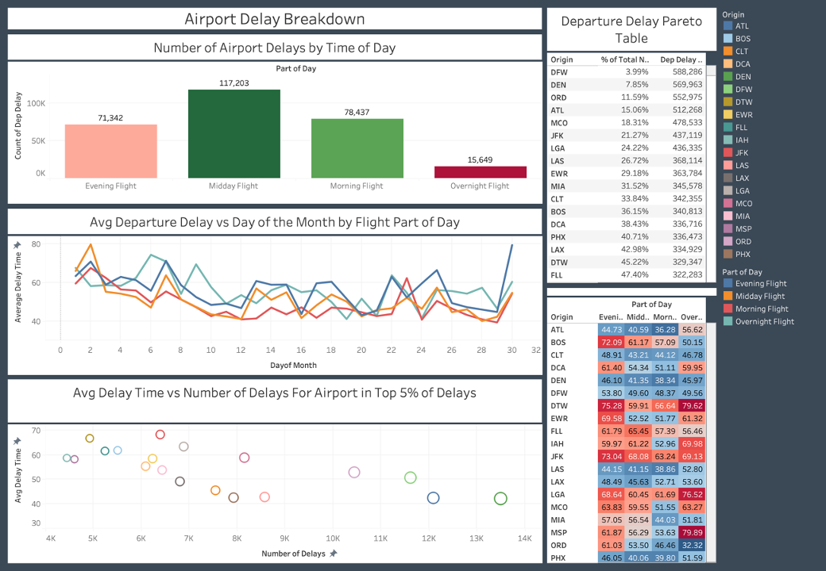
Breakdown of Airport Delays
17 airports are the cause of 50% of delays
The longest delays occur during evening and overnight flights
Customers should target traveling during the middle of the month as delay times are lower

Slide 30
Business Implications

Slide 31
Business Implications
AIRLINES
AIRPORTS
Green marketing is a practice whereby companies seek to go above and beyond traditional marketing by promoting environmental core values in the hope that consumers will associate these values with their company or brand. Engaging in these sustainable activities.
Revise policies regarding crew scheduling and maintenance to reduce delay causes.
Identify the most delay-prone flights and take proactive measures such as better resource allocation or schedule adjustments.
17 Airlines cause 50% of delays.
Enhance infrastructure to handle peak-time more efficiently.
Improve collaboration with airlines to streamline operations during high traffic conditions.
Delay times are lower during middle of the month and higher in rural states.

Slide 32
Business Implications
REGULATORS
TECHNOLOGY PROVIDERS
Green marketing is a practice whereby companies seek to go above and beyond traditional marketing by promoting environmental core values in the hope that consumers will associate these values with their company or brand. Engaging in these sustainable activities.
Facilitate better data sharing between airlines and airports to improve overall efficiency and delay handling.
Implement policies to reward efficient delay management by airlines and airports or penalize excessive delays.
5% Airports causing 50% delays
Booking systems that suggest off-peak travel times and less congested airports.
Offer solutions for real-time passenger communication during delays.
Evening, overnight and flights over weekends more likely to be delayed.

Slide 33

Thank you
QUESTIONS?

